Slide 1
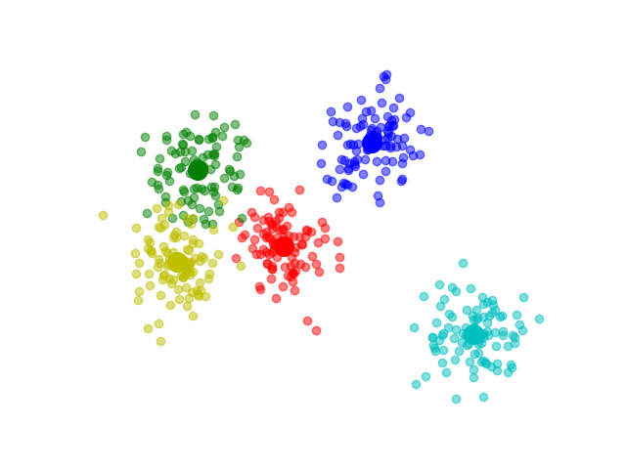
UNSUPERVISED LEARNING
Classification methods
k-Means

Slide 2
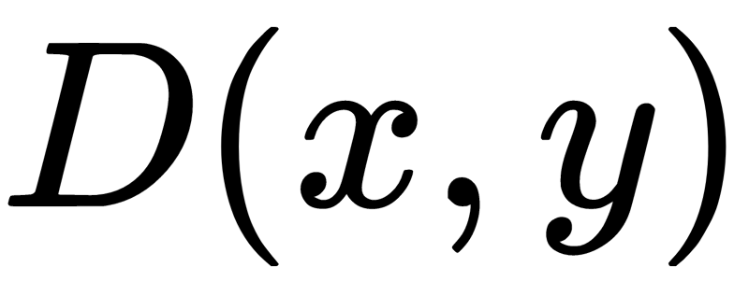
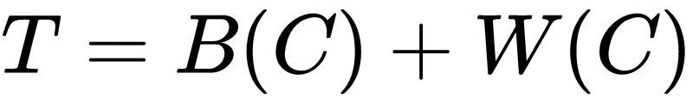
Distance Function and number of clusters K.
Find To Minimize W(C).
So minimization of W(C) is the same as maximisation of B(C).

Slide 3

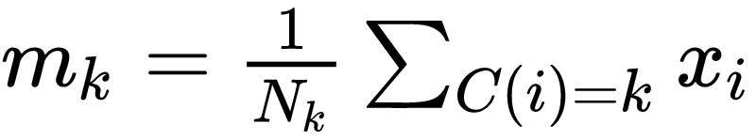
Using Euclidean Distance
Where m_{k} is mean of cluster
And N_{k} is number of points in cluster.

Slide 4

K-Means Algorithm
Randomly Initialize means of clusters from data.
Find cluster of each datapoint with
Recalculate means.
Repeat step 2 and 3 until convergence.

Slide 5
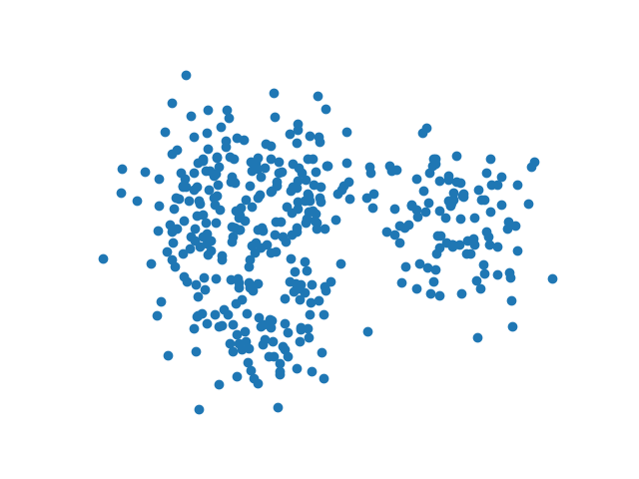
Random Data

Slide 6
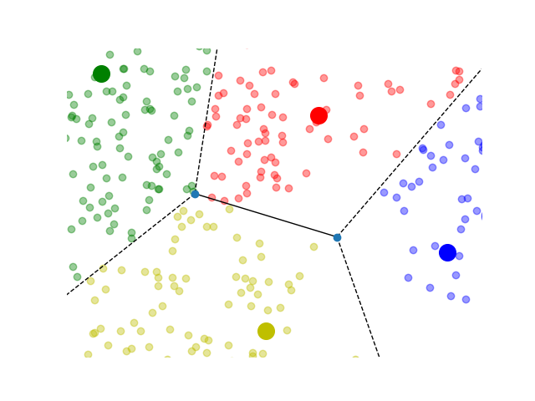

Slide 7
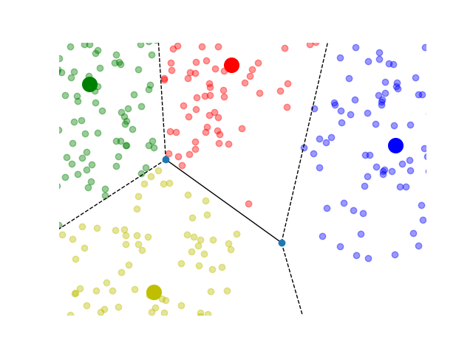

Slide 8
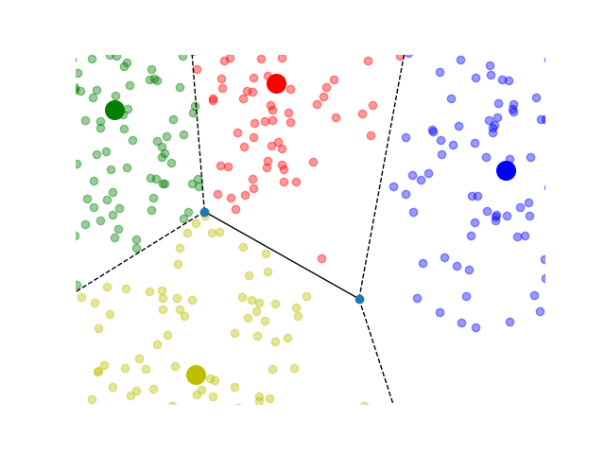

Slide 9
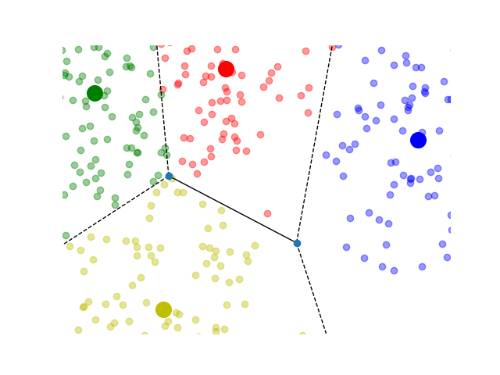

Slide 10
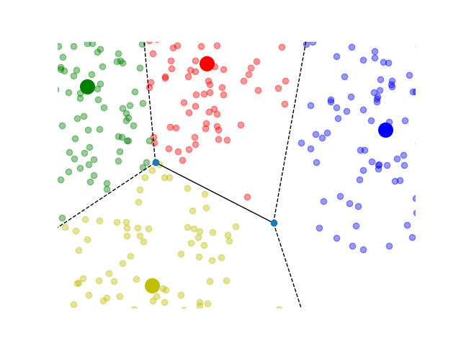

Slide 11
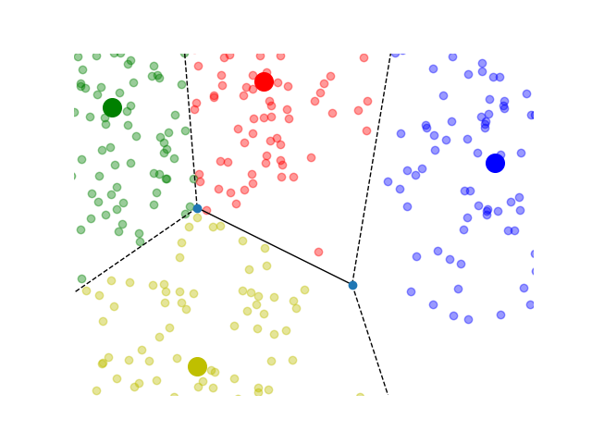

Slide 12
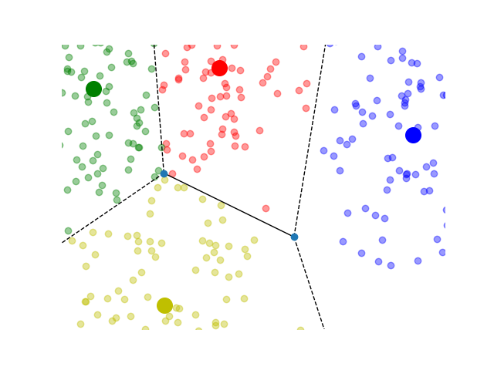

Slide 17
Vector Quantization

Slide 18
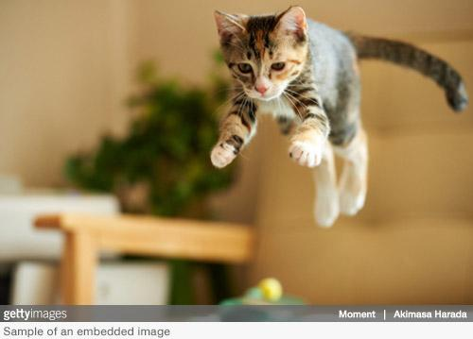
Original Image

Slide 19
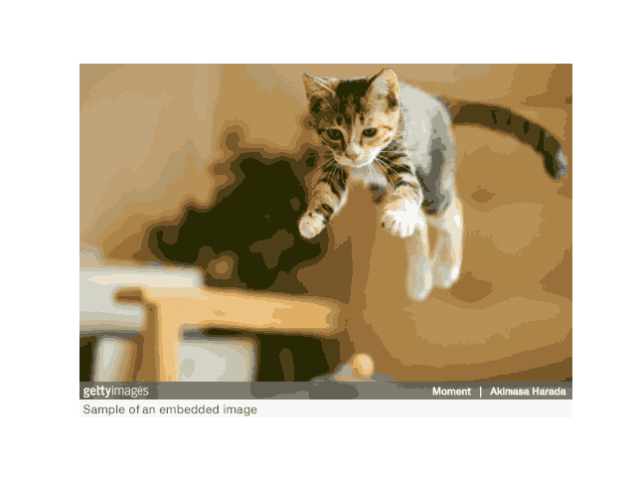
K = 20

Slide 20
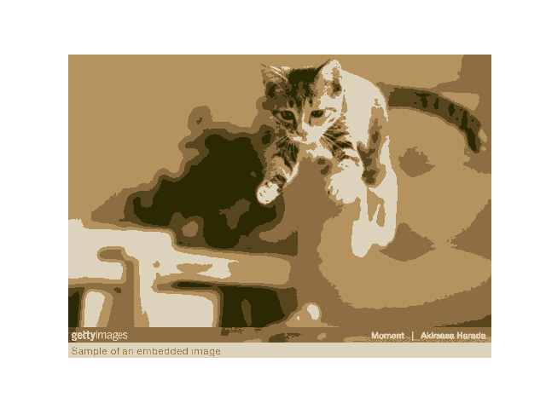
K = 5

Slide 21
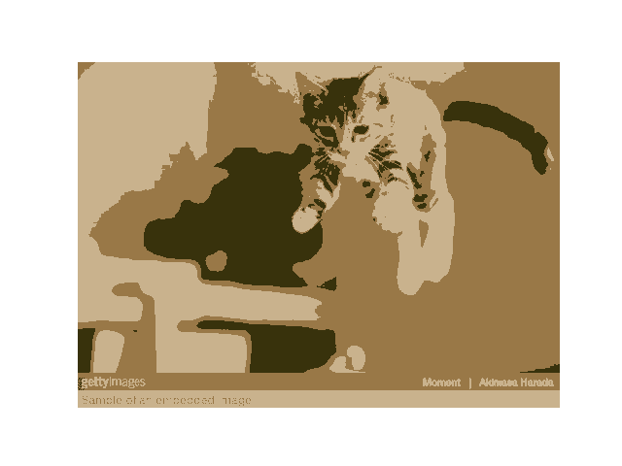
K = 3

Slide 22
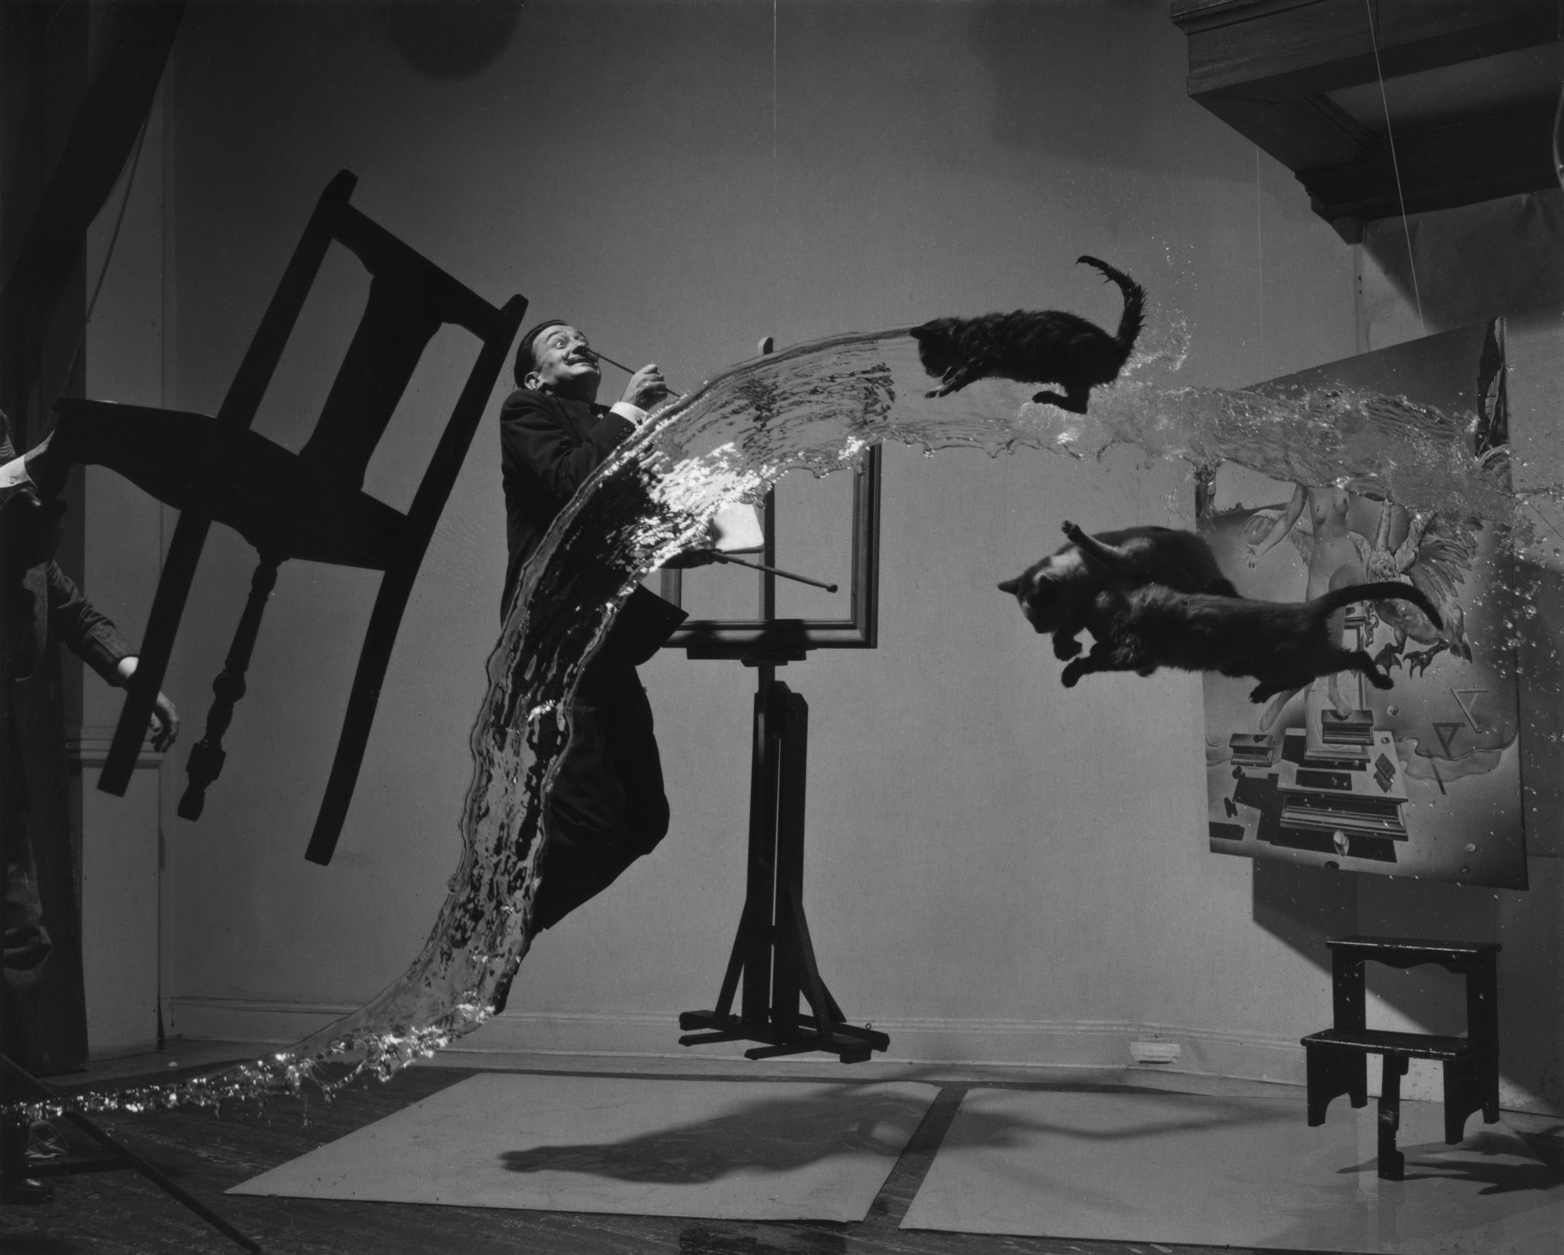
Dali Atomicus

Slide 23
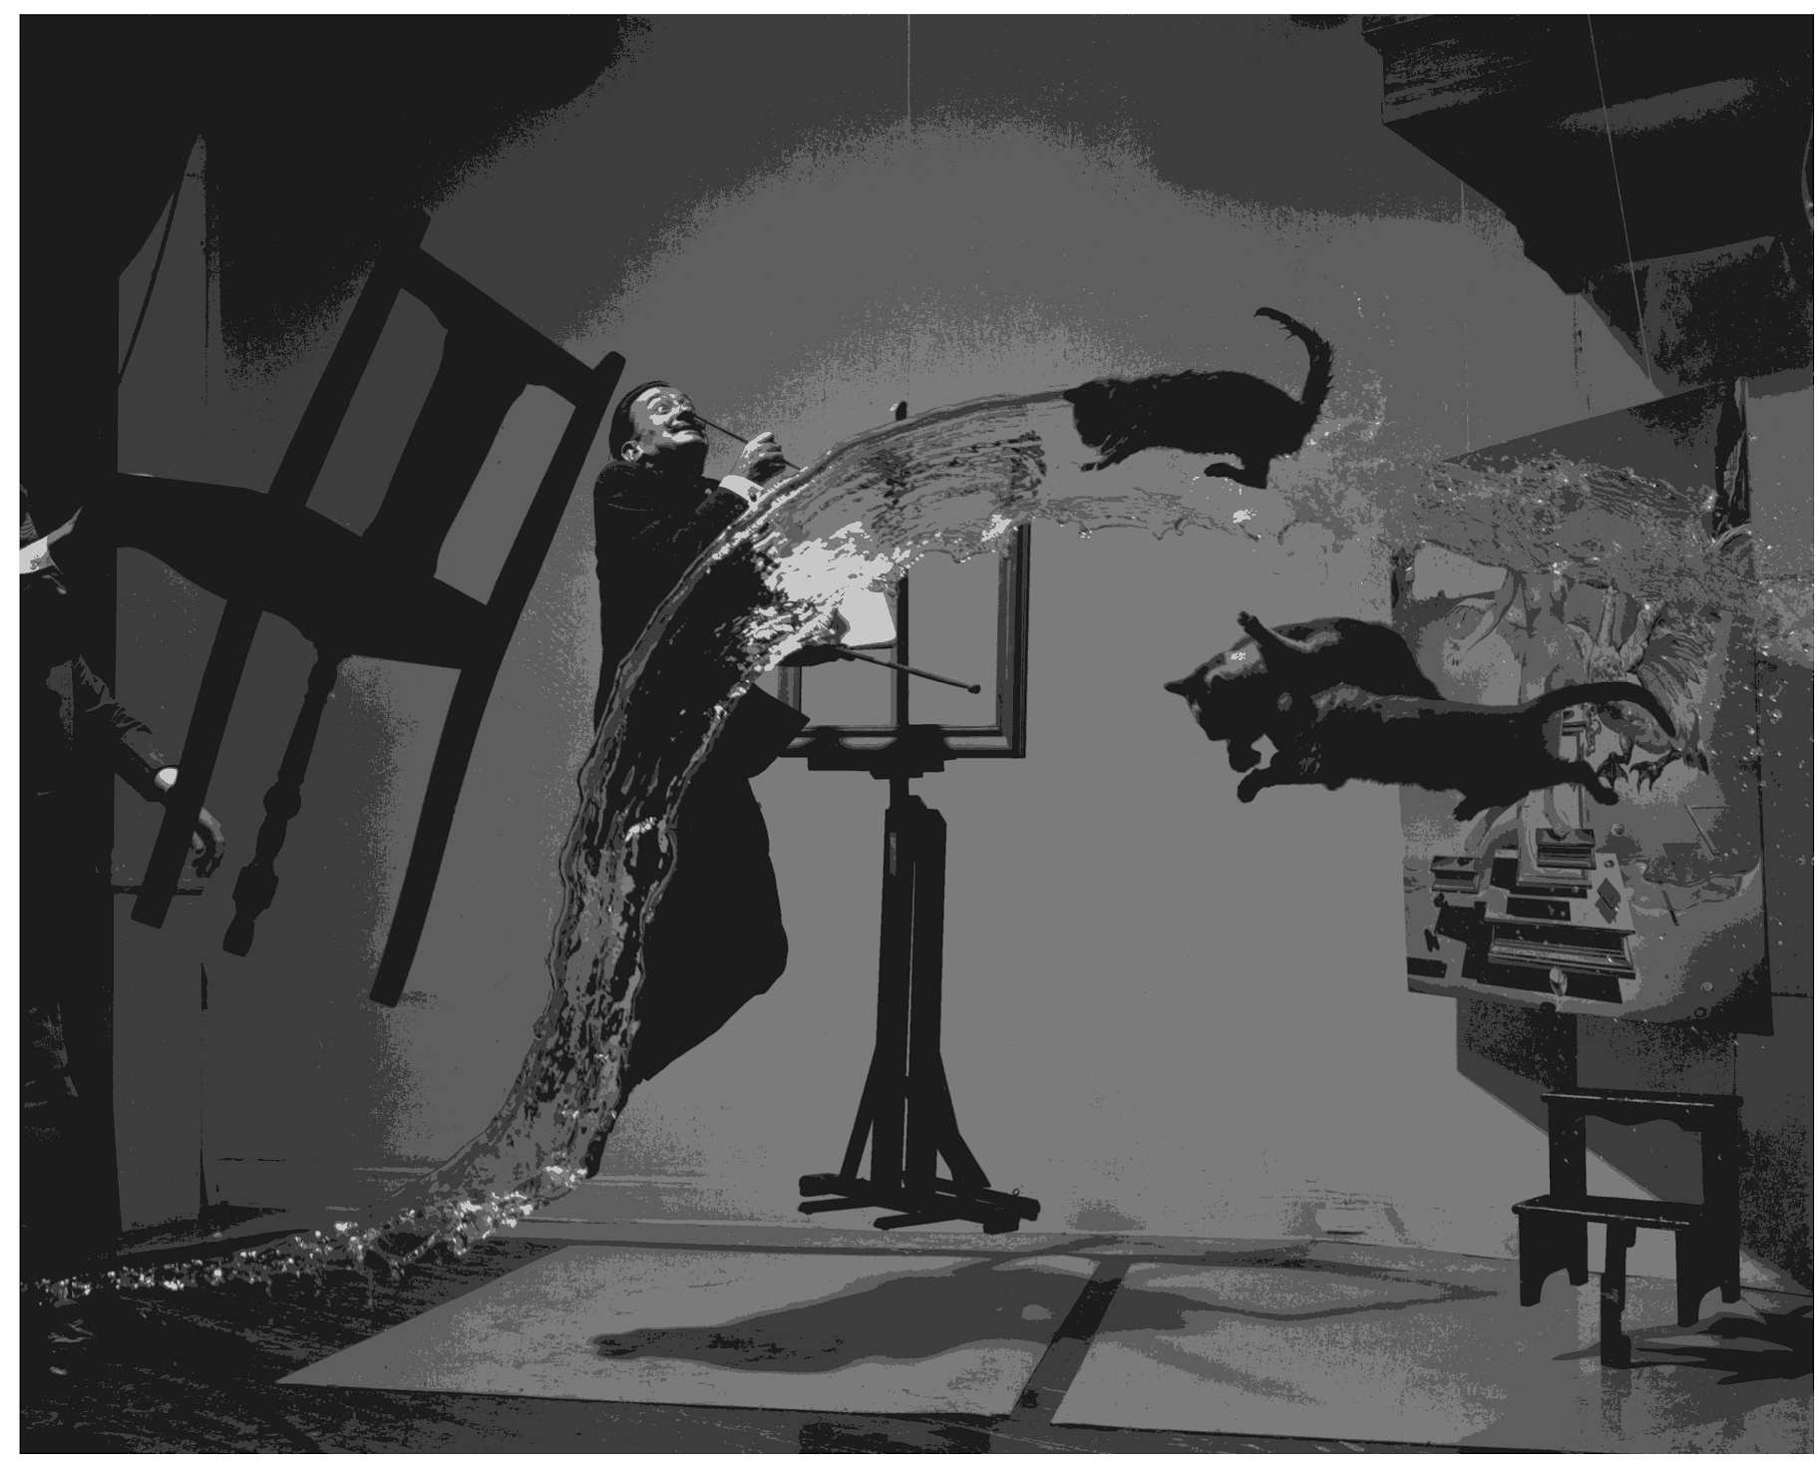
K=5

Slide 24
K Means++
K Medoids

Slide 25
K Means++
Randomly (uniform) choose point from data as first mean.
For each datapoint calculate distance from nearest mean.
Pick new mean randomly with weighted probability proportional to calculated distances.
Repeat 2, 3 until you have chosen K means.

Slide 26

K Medoids
Randomly choose K points from data.
Find cluster of each datapoint with
Where m_{i} is center of i-th cluster.
Find mean of cluster with
Repeat 2, 3 until assignments do not change.

Slide 27


